Slide 1
CLASSROOM MANAGEMENT Kylee Leingang & Shaylynn Mack

Slide 2
Building Relationships (pg. 21)
Choices (pg. 142)
Shared Control (pg. 135)
Savings Account (pg. 31)
One sentence intervention →Ripple Effect
Enforceable Statements (pg. 26)
Setting Limits

Slide 3
Marzano
Engagement
Energy Levels
Positive Teacher
Rules and Procedures
Clear limits
Effective questioning
Working memory
Pressure
Competitions
Controversy
Game-like
Group work

Slide 4
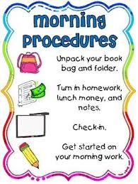
Harry Wong
Procedures
Teach, Rehearse, Reinforce
Opening Assignments (pg. 75)
Morning meeting (pg. 170)
Bell-work
Preparation (pg. 16)
Notes:
Kylee Leingang’s Philosophy- I believe in establishing a positive environment by building trusting relationships, implementing clear, limited procedures, and encouraging respect. I want my students to feel safe and willing to use respect and collaboration to encourage each other. I believe in being a caring teacher with high, reasonable expectations which will encourage positive development as a whole individual.
Shaylynn Mack’s Philosophy – I will create an organized and structured classroom with constant expectations while building positive relationships with each individual student. Along with giving them independence and choices to stay self motivated. I feel it is important to keep the students highly engaged and excited about learning.

Slide 5
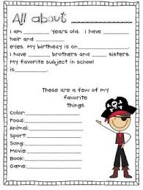
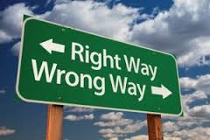
First Days
Prepare and Implement Procedures
List on door or wall
Practice/model
Getting to know you activities
Ideal school writing
All About Me booklet
Model the wrong way, model the right way
Make video
Notes:
The first few days we would follow Wong’s 10 day plan. We plan on using the first days to get to know our students to make them comfortable within the classroom environment. We would begin working to establish relationships as Love and Logic supports. We would then take the first days to teach, rehearse, and reinforce procedures. We will do this through repetitive practice, modeling, and constant reminders for the students. We will focus on establishing a positive environment with clear expectations through reminders, examples, and procedures.

Slide 6
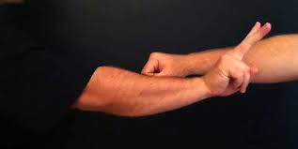
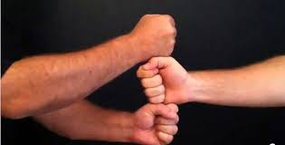
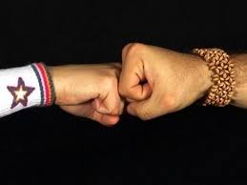
Greeting
Something new every day
Air high fives
Fist bumps
Turkey
Snowman
Jellyfish
Elbow Bumps
Notes:
Greeting the students at the beginning of each day is one procedure we would like to implement immediately. This creates a positive and safe environment by making the students feel welcome. This is an important step to implement right away to give students a positive vibe as they enter the classroom and are ready to begin each day.

Slide 7
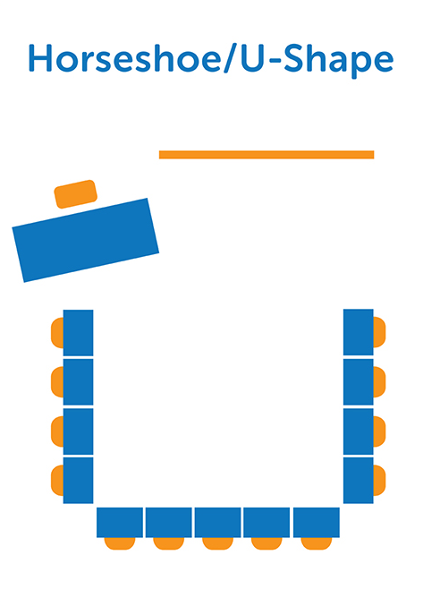
Seating
Use tables
Flexible seating
Option to move
Notes:
The students will have the option to have flexible seating. We would like to provide the students with the option to move locations throughout the day. Each student will choose a spot in the morning and have the opportunity to choose a different spot in the afternoon. The student may choose their seat as well. If a student is inappropriately using the seating choice, they will be given a regular school chair. If two students argue over a seat, they will be expected to solve the conflict using strategies such as one student has the seat in the morning the other student has it in the afternoon or simply selecting another option. If the students are unable to solve this problem on their own then neither student will be allowed to have that seat and they will be asked to find another option.

Slide 8
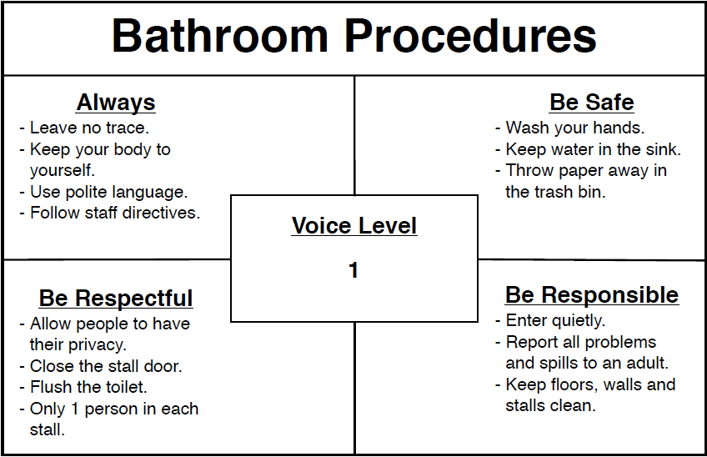
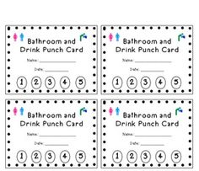
B
A
T
H
R
O
O
M
Notes:
The students will be given a bathroom punch card at the beginning of each week. The punch card will allow them to leave the room five times throughout the week to use the bathroom or get a drink. The students will be able to go to the bathroom without having to get a punch during snack and recess times. This will encourage the students to use the bathroom at times other than instructional times. The bathroom procedures will be hung up on the door so the students can be reminded of their expectations before they leave the room. Emergencies will be handled differently and students will be able to go without a punch.

Slide 9
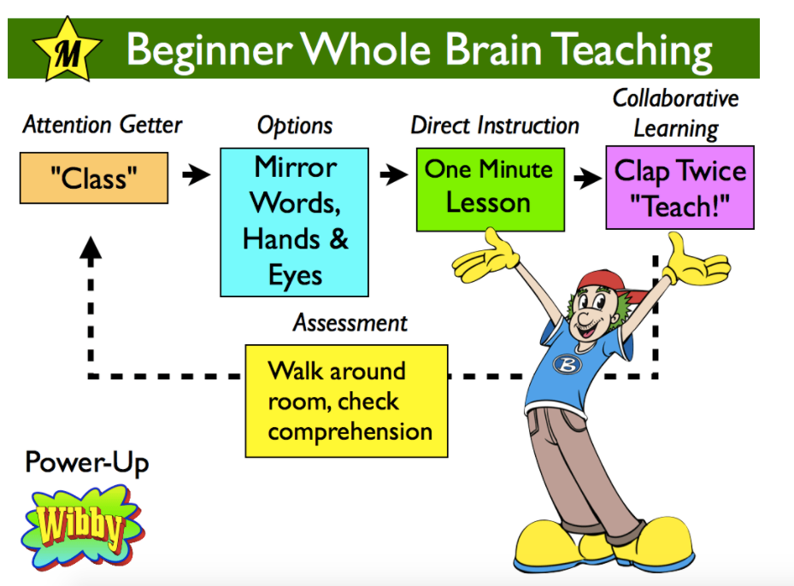
Discussions
Use a ball or other object
Mirror Student-Teach
Turn and Talk
Notes:
We want to implement many talking opportunities for our students. These opportunities may come in whole group discussions or small group discussions. A ball could be used to facilitate a whole group discussion where the ball would designate one person as the speaker. The ball could then be passed around as the discussion continues to expand. Small group turn and talks could be used as well using a student teach method as the diagram explains. The students will respond to the teachers chant of “class” with a “yes” to ready themselves for a lesson. We will give a short minute lesson involving movement and conclude the lesson with clapping twice and saying “teach” and the students respond clapping twice and saying “okay” and they will turn and teach their partner about the lesson. We will walk around during this time to look for comprehension of the material.

Slide 10
Lining Up
Tape
Days of the week
Mondays, Tuesdays, Wednesdays, Thursdays, Fridays
Notes:
We will have a designated line up area lined in tape. This will prohibit the students from lining up too close to the door and make sure the students remain in a single file line. The students will be given a day of the week during the first day of school. The students will then be asked to line up according to the days of the week. For example, if a student is a Tuesday, he will be able to line up first on Tuesdays. This allows us to control the students as they line up for various reasons.

Slide 11
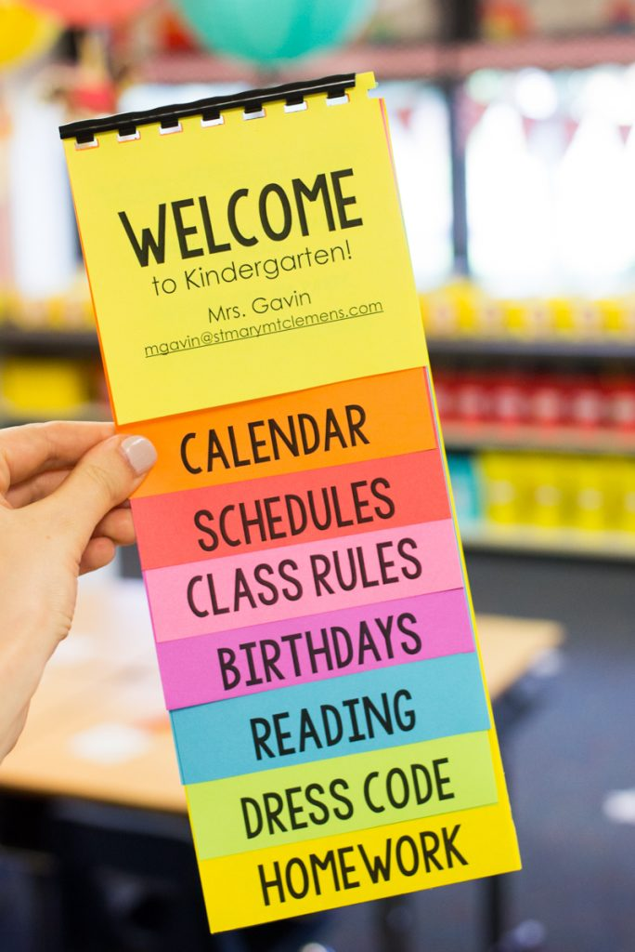
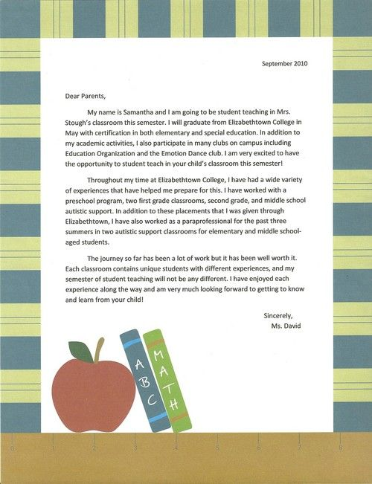
Parent-Classroom Communication
Notes:
We want to involve the parents as much as possible with the classroom and learning experiences their children will have. We will welcome the students and parents with a letter home before the first day of school. The letter will contain our contact information, a little background information about who we are, and highlight our excitement for the upcoming year. This will hopefully establish a positive relationship with both our students and the parents of our students. We will invite the parents to introduce themselves through the schools open house or other appropriate times before school. We will also be sending home a welcome package with the students on the first day. This will include a school schedule, calendar, the class rules, appropriate birthday treats, appropriate snack choices, the dress code, and homework expectations. This will be something the parents can keep to reference throughout the year. Not only do the students need to be aware of the procedures and expectations, but the parents need to be aware of them as well. This will eliminate any unwanted surprises to discuss with the parents throughout the year about the school’s policies.

Slide 12
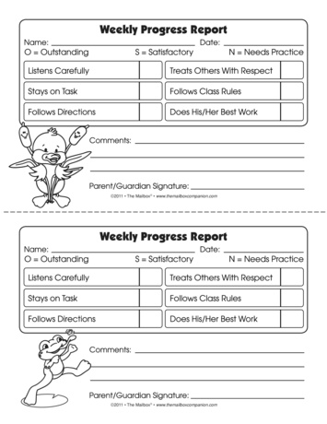
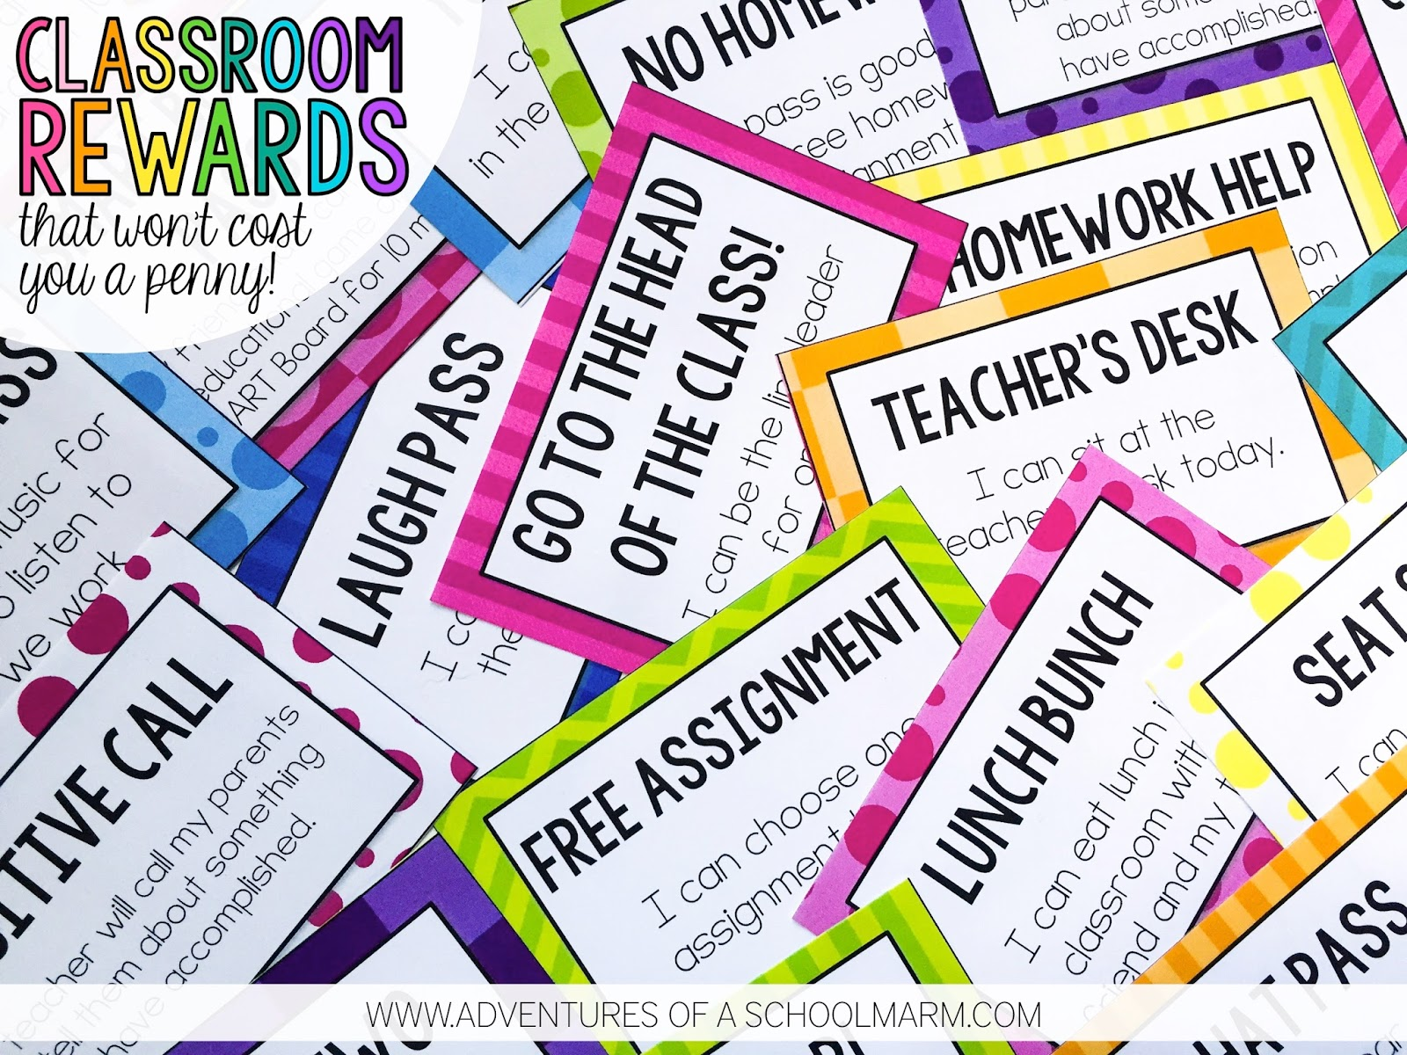
BEHAVIOR
Notes:
The students will have the opportunity to earn tickets throughout the year. The tickets can be rewarded through positive behavior and hard work. If a student shows respect to another student by going above and beyond to help them, they may receive a ticket. There are many different ways a student can earn a ticket which will encourage respect and establish a positive community within the classroom. The students will keep track of their earned tickets and have the opportunity to “spend” their tickets. The tickets will be spent on nontangible items including special privileges like going first in line or eating lunch with the teacher. The students will decide when they would like to spend their tickets and they are responsible for the tickets at all times.
Poor behavior will be addressed using the district policy. Communication with the parents will be a great focus for managing poor behavior. The students will be taking home a weekly behavior report at the end of the week. If problems arise within the classroom they will be documented on this behavior report with one copy sent home to the parents. Other communication with parents will occur by telephone or email. We want the parents to be a part of behavior issues as we believe this can be very effective in limiting unwanted behavior.

Slide 13
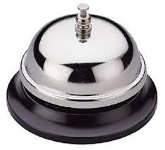
Noise – Attention Getter
Notes:
Our attention getter will begin with a recognizable sound where the students can direct their attention to the teacher. However, throughout the year we hope to adjust our attention getter. We want our attention getter to be a fun element to implement within the classroom based on the students interests. After we take the time to get to know our students, we would like to adjust our attention getter to relate to them personally. For example, if the class really enjoys “Finding Nemo” , the movie, the attention getter might be “Shark Bait” and they respond with “Ooh HA HA”. This is a fun way to develop a personal relationship with the students and keep them engaged in the classroom. The attention getter may also be used to reinforce class content. An example of this would be using a vocabulary word as the attention getter where students will repeat back the definition to show they are ready to learn. There are many different attention getter options we would like to use, but we would like to differentiate our attention getter based on our student’s needs whether the attention getter needs to be a visual or auditory message.

Slide 14
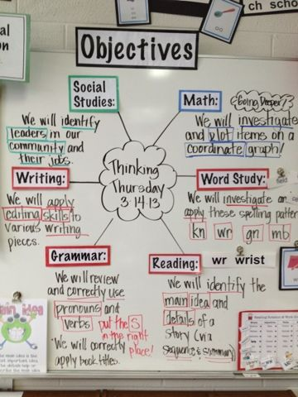
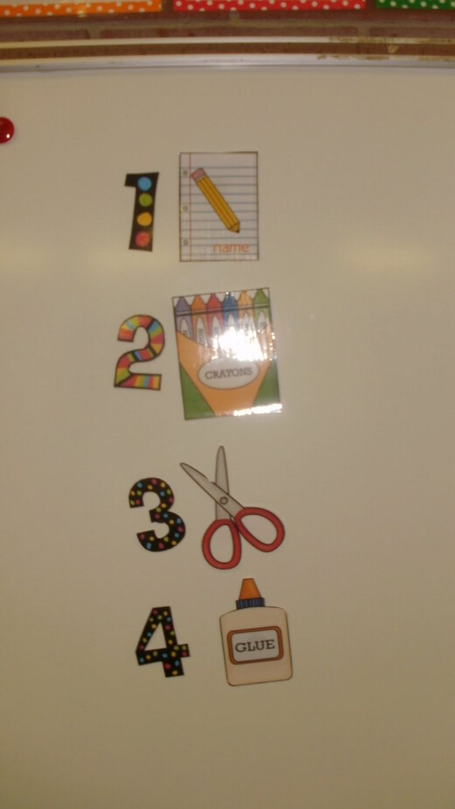
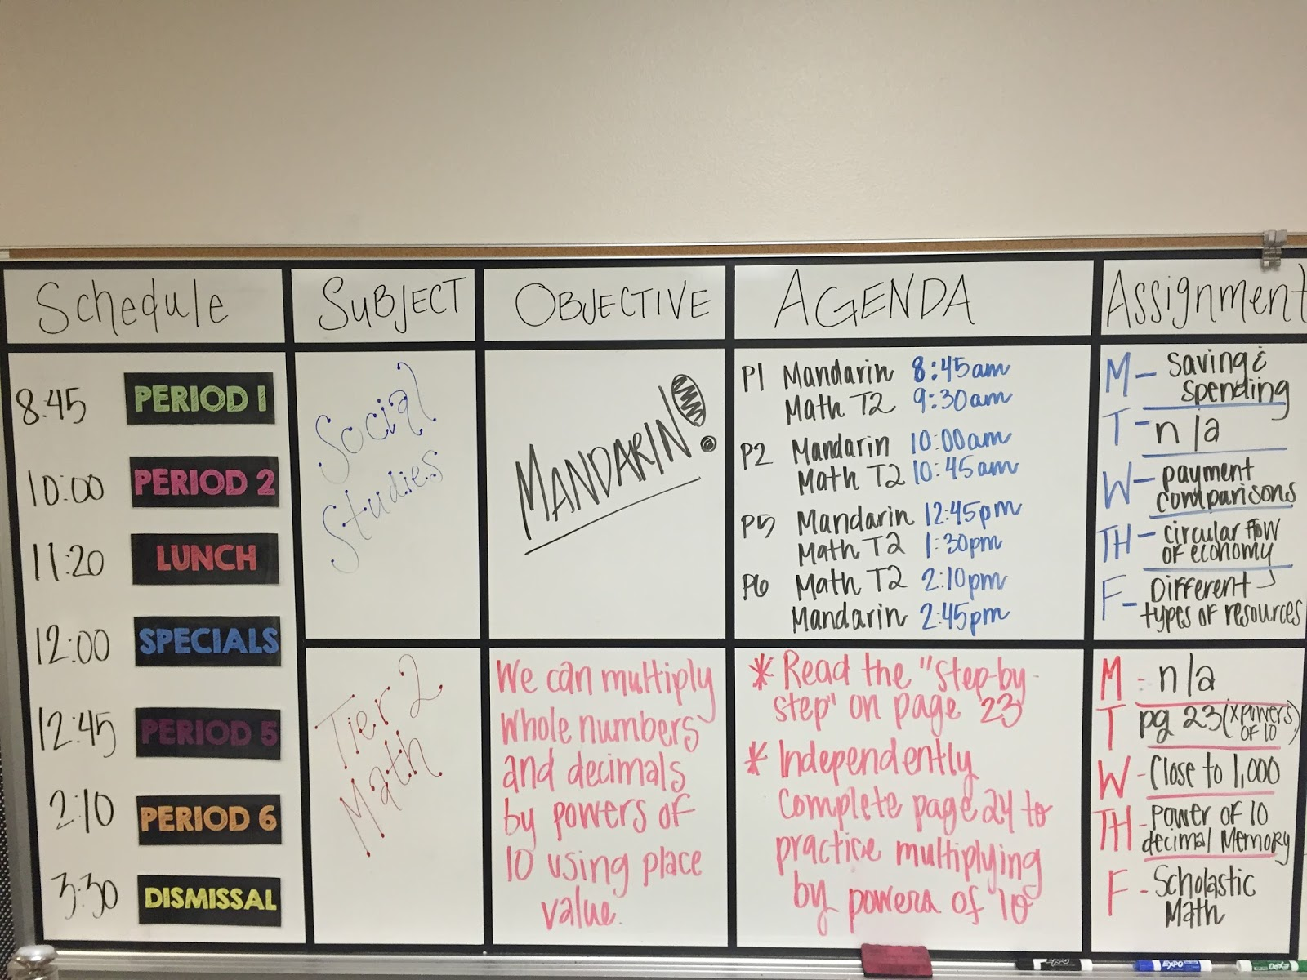
Agenda
Notes:
We would like to combine the three agendas above for our classroom. We would like our agenda to be detailed but neat. We would like a description to be under each subject area as they are in the first photo on the left. We would also like to list possible supplies within our agenda so the students can refer to the agenda when they need to gather appropriate supplies as the middle photo represents. The photo on the right is the type of structure we would like to have as the agenda is neat and organized. We would like the students to be able to refer to the agenda for many of their repetitive questions. We want them to understand what they will be doing, the materials they need, and what time each activity will be taking place in order to eliminate any unnecessary questioning or confusion.

Slide 15
References
Marzano, R. J. & Pickering, D. J. (2003). Classroom Management that Works: Research –based strategies for every teacher. ASCD Press: Alexandria, VA.
Fay, J. & Funk, D. (1995). Teaching with Love & Logic: Taking control of the classroom. Love & Logic Press Inc: Golden, CO.
Wong, H. K., Wong, R. T., Jondahl, S. F., & Ferguson, O. F. (2014). The Classroom Management Book. Mountain View: Harry K. Wong Publications, Inc.

