Slide 1
Do you want to travel back in time?

Slide 2
I can
I CAN read a script excerpt from our reader's theater
I CAN stress certain words to emphasize meaning and patterns of a text
I CAN make my reading sound like talking
5.SL.1 Engage effectively in a range of collaborative discussions, topics and texts, building on others’ ideas and expressing their own clearly

Slide 3
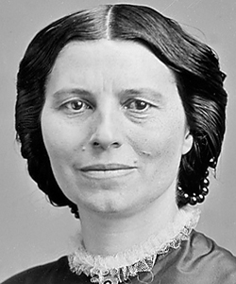
Go back in time to the 1800s and find this woman:
MISSION:

Slide 4
Before you go….
YESTERDAY, WE PRACTICED STRESSING WORDS WHILE
READING A POEM
TODAY, LISTEN TO HOW WE CAN ADD STRESS TO THE SCRIPT
BLAST OFF

Slide 5
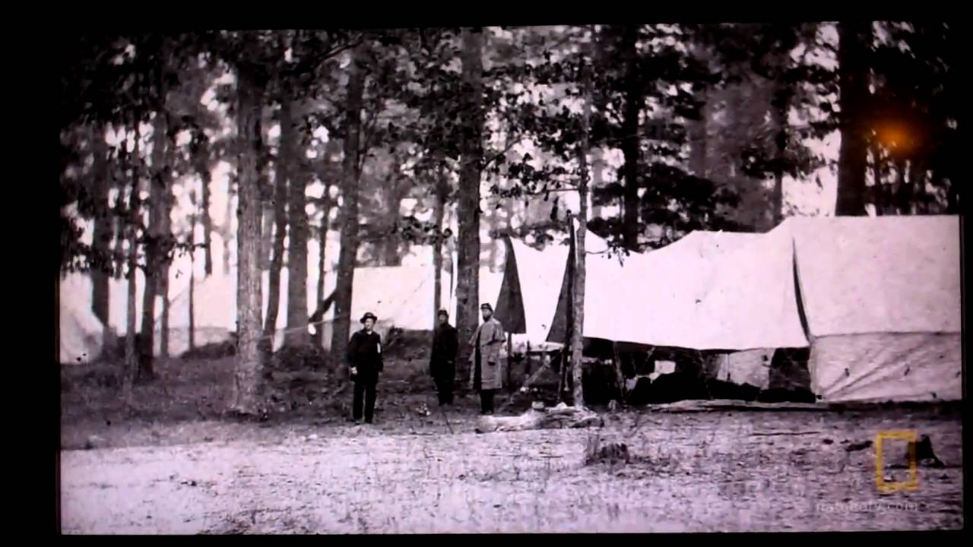

Slide 6
What was Clara Barton like?
CLARA BARTON

Slide 7
YOUR TURN
TAMMY

Slide 8
READER'S THEATER ROLE ASSIGNMENT
CHARACTER | GROUP 1 | GROUP 2
DAD (23) 1-8, 9-16 | JEFF/GARRETT | SYD/EMERSON
TAMMY (24) | KENDRA/RILEY | DYLAN/HUNTER
DAVID (7) | DRU | BAILEY
CLARA (16) | KADEN | ALYSON
ELIZA (6) | TYLER | LANDON
GLEN (7) | NICK | HAYDEN

Slide 9
FRIDAY, MARCH 31
DAILY STATIONS
** READ TO SELF (20 MIN)
** CHARACTER DESCRIPTION- TAMMY
** WORD STUDY DAY 5
** READ READERS THEATRE PARTS
READ TO SOMEONE (LEVEL 1)
** Are a must to complete
* Are a need to complete
Voice level 0-1 at all times!

