Slide 1
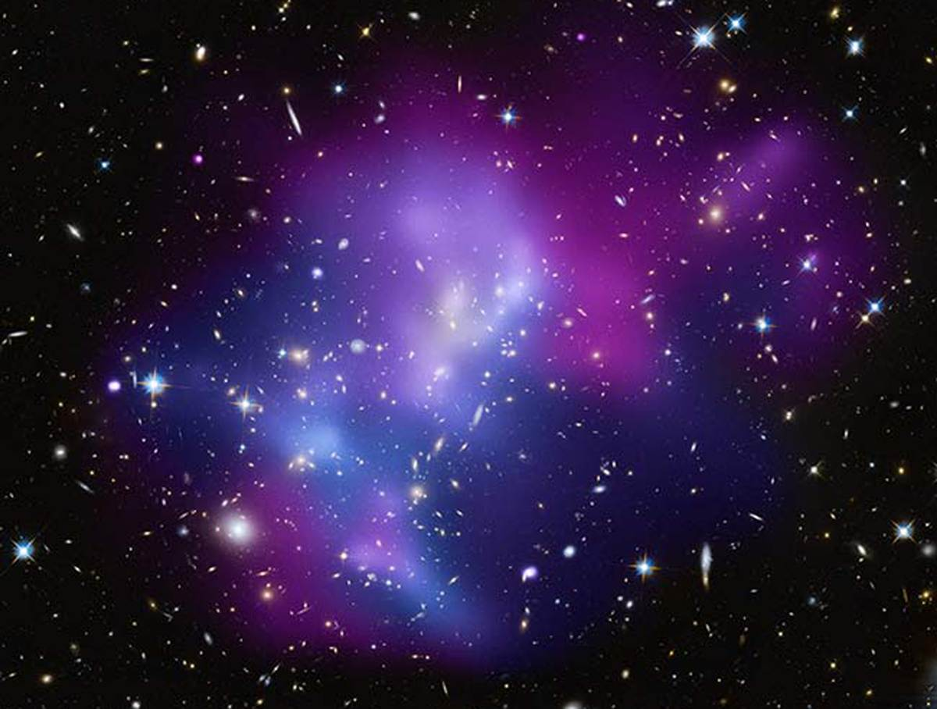
Compare & Contrast

Slide 2
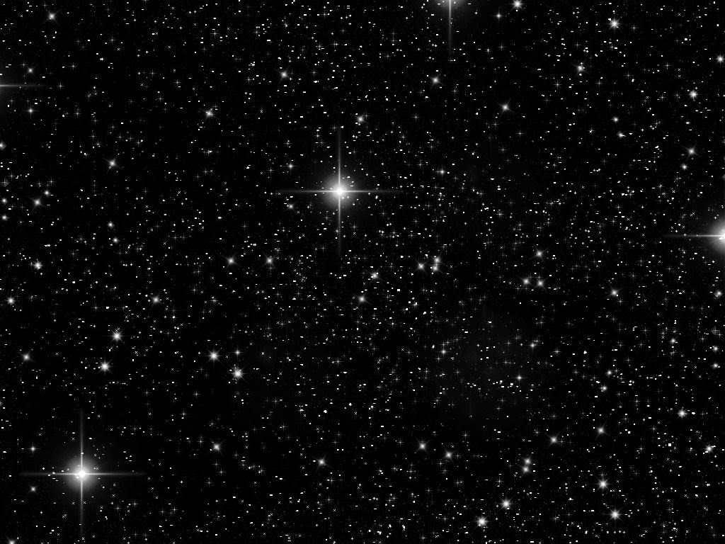
Compare & Contrast
I CAN identify comparisons and contrasts in a picture
I CAN identify and use signal language for comparing and contrasting
I CAN determine important information in a picture
5.RL.3 Compare and contrast two or more characters, settings or events in a story or drama, drawing on specific details in the text (e.g. how characters interact)
5.SL.1abc Engage effectively in a range of collaborative discussions, topics and texts, building on others’ ideas and expressing their own clearly

Slide 3
Compare & Contrast Recap
Airplanes Then and Now
What did we look at?
Think Aloud – Why is it important?
What signal words did we use?

Slide 4
Compare & Contrast
LET'S TAKE A TRIP

Slide 5
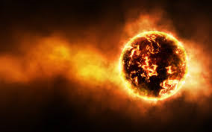
Planet Chelula
We have arrived! This planet has an average temperature of 2150◦ Fahrenheit. The planet has a diameter of 3963 miles. This planet does not experience any change in the weather! It is very cold outside today. There has never been snow on this planet or any form of water. Both animals and insects are not present on the planet. Lady bugs crawl on trees sometimes. Our planet is made of rock and lava. Nobody has ever traveled to our planet.

Slide 6
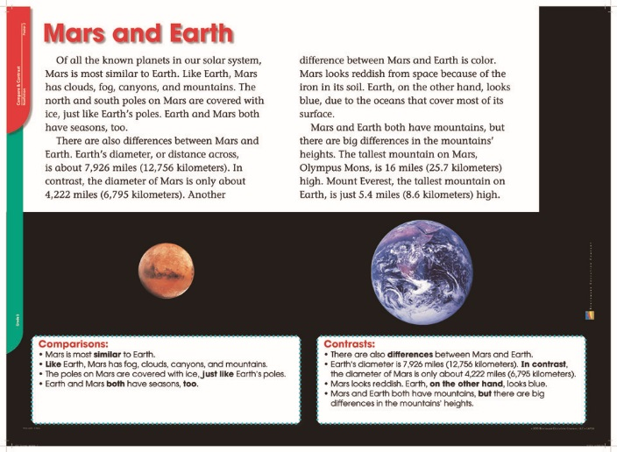
Mars and Earth

Slide 8
Determine Text Importance
What is the most important information in the passage?
Compare and Contrast:
FIND SIGNAL WORDS!

Slide 9
Reader’s Journal
One way Mars and Earth are alike is _________.
One way Mars and Earth are different is ______.
Signal words that helped me compare and contrast are _____.

Slide 10
Thursday, February 9
Daily Stations
Read to self (20 min)
** Word Study Day 4
** Reflection Q’s -3 Sentences
** Work on writing – gather facts
Read to someone (Level 1)
** Are a must to complete
* Are a need to complete
Voice level 0-1 at all times!

